Slide 1
Verbals

Slide 2
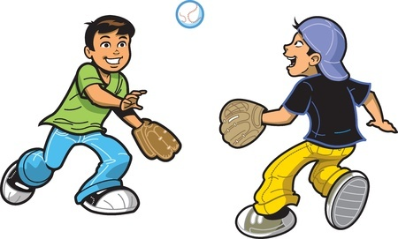
Verbals
Verbs acting as other parts of speech
Examples
Milton wanted to eat cookies.
Listening to music makes me happy.
The boys played for a cheering crowd in their minds.

Slide 3
Gerunds
-ing verb acting as a noun
Example
Kelvin loves playing baseball.
What is the action in this sentence?

Slide 4
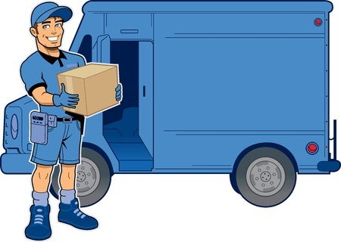
Infinitives
to and a verb acting as a noun or adjective.
Example
The delivery man was waiting to drop off the package.
What is the action in this sentence?

Slide 5
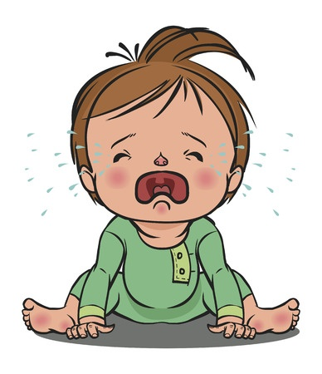
Participle
-ing or -ed verb acting as an adjective.
Example
The baby, tired from a long day of play, cried without end.
What is the action in this sentence?

Slide 6
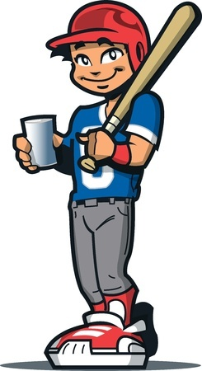
The Dangling Participle
Starting a sentence with a participle that does not refer to the subject.
Avoid These!
Example
Steaming from the heat, the baseball player carefully sipped his hot cocoa.
What is this sentence actually saying?

Slide 7
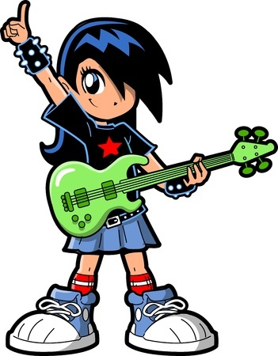
More Examples of Verbals
Polly was playing for a screaming crowd.
What is the verbal in the above sentence and what type of verbal is it?
screaming
Participle (verb acting as adjective)

Slide 8
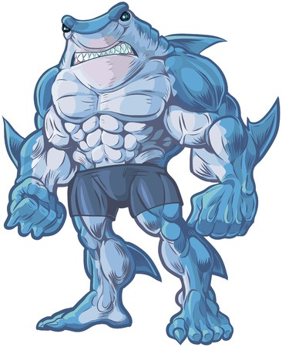
More Examples of Verbals
Shark Man wanted to fight a surfer.
What is the verbal in the above sentence and what type of verbal is it?
to fight
Infinitive (verb with to acting as a noun or adjective)

Slide 9
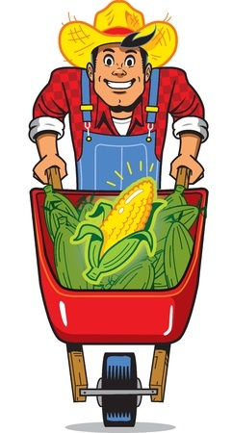
More Examples of Verbals
Harvesting corn sure cheers up Farmer Brown.
What is the verbal in the above sentence and what type of verbal is it?
Harvesting
Gerund (-ing verb acting as a noun)

Slide 10
Review
Verbals act as nouns or adjectives.
Participles act as adjectives.
-ed or -ing verbs
Gerunds act as nouns.
-ing verbs
Infinitives usually act as nouns.
to and a verb

